Slide 1

Git Lecture-3
www.corvit.com

Slide 2
Topics
Stash
Connecting Remote Repository to Local Repository
Branches
Fork
Pull Request
Syncing Forked Project with Main.
Squashing Commits
Merge Conflicts
Cherry Picking
Git Cheat Sheet
www.corvit.com

Slide 3
Stashing Changes
When some changes are made and staged but those changes are not required we can unstage them. There is another way of omit those and that is through “git stash”.
git stash (this command clears your working directory and removes all changes, those changes cannot be seen in unstaged area as well. Git has a special back stage place which is known as stash, all these stash changes are placed there).
Git stash pop (brings all stashed changes back to unstaged area)
Git stash clear (clears all changes placed in stash area. Once stash is cleaned changes cannot be restored anymore).
www.corvit.com

Slide 4
Connecting Remote Repository To Local Repository
Create a empty repository on Git hub
git remote add origin <quick setup repo URL>
git remote -v (list all origins attached to your project)
git push origin <branch name> (to push all changes from your local repository to github account)
www.corvit.com
Notes:
By convention all repos, files and folders in your git account are named as origin.

Slide 5
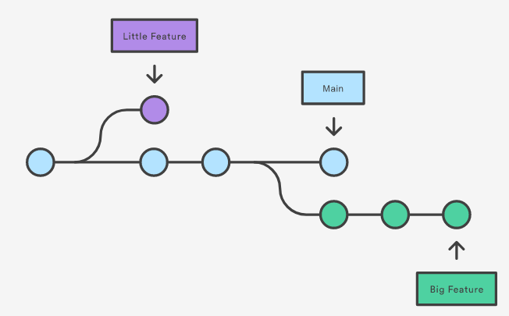
Branches
A branch represents an independent line of development.
Branches serve as an abstraction for the edit/stage/commit process.
You can think of them as a way to request a brand new working directory, staging area, and project history.
New commits are recorded in the history for the current branch, which results in a fork in the history of the project.
www.corvit.com

Slide 6
Branches
HEAD is the pointer which points to the current branch.
Main/Master is the branch which contains the stable code and is available for users or clients.
Git branches are used when multiple users are contributing to the same project and making changes to the same repository.
Every user can have his own branch and can work on it separately and merge that branch in the Main branch
Never make commits to Main directly, always make a new branch and made changes to that and after testing merge it to Main.
You can create an empty or copy it from Main or any other branch.
www.corvit.com

Slide 7
Branches
git branch <branch name> (creates a branch in your local repo but dose not switch the HEAD to that branch. The new branch would be a copy of the branch which HEAD would be pointing)
git branch or git branch --list (lists all branches in your local repo )
git branch -a (lists all remote branches)
git branch -d (deletes branch but doesn’t delete a branch with unmerged changes)
git branch -D (deletes branch with unmerged changes)
git push origin --delete <branch name> (delete branch remotely as well)
git branch -m <new branch name> (to rename the branch)
www.corvit.com

Slide 8
Branches
The git branch command lets you create, list rename and delete branches. It doesn’t let switch between branches or put a forked history back together. For this reason git branch is tightly integrated with the git checkout and git merge commands.
git checkout <branch name> (to switch to other branch)
git checkout -b <branch name> (creates a new branch and switch to it)
git checkout -b <new branch name> <source branch name > (to create a new branch copy of another)
git merge <branchname> (to merge your branch to main)
www.corvit.com

Slide 9
Branch Strategy
Distributed version control systems like Git give you flexibility in how you use version control to share and manage code. Your team should find a balance between this flexibility and the need to collaborate and share code in a consistent manner.
Team members publish, share, review, and iterate on code changes through Git branches shared with others. Adopt a branching strategy for your team. You can collaborate better and spend less time managing version control and more time developing code.
www.corvit.com
Notes:
https://learn.microsoft.com/en-us/azure/devops/repos/git/git-branching-guidance?view=azure-devops

Slide 10
Branch Policy
Branch policies are an important part of the Git workflow and enable you to:
Isolate work in progress from the completed work in your main branch
Guarantee changes build before they get to main
Limit who can contribute to specific branches
Enforce who can create branches and the naming guidelines for the branches
Automatically include the right reviewers for every code change
Enforce best practices with required code reviewers
www.corvit.com
Notes:
https://learn.microsoft.com/en-us/azure/devops/repos/git/branch-policies-overview?view=azure-devops

Slide 11
Branch Security
Branch protection rules are a crucial part of securing source control management systems. Azure DevOps branch policies enable administrators to add tests that new code, in feature branches, must pass prior to being merged into the master branch.
www.corvit.com
Notes:
https://cycode.com/how-to-setup-branch-protection-rules-in-azure-devops/

Slide 12
Implementing Branch Strategy
Creating Reviewers & Branch Policy
www.corvit.com

Slide 13
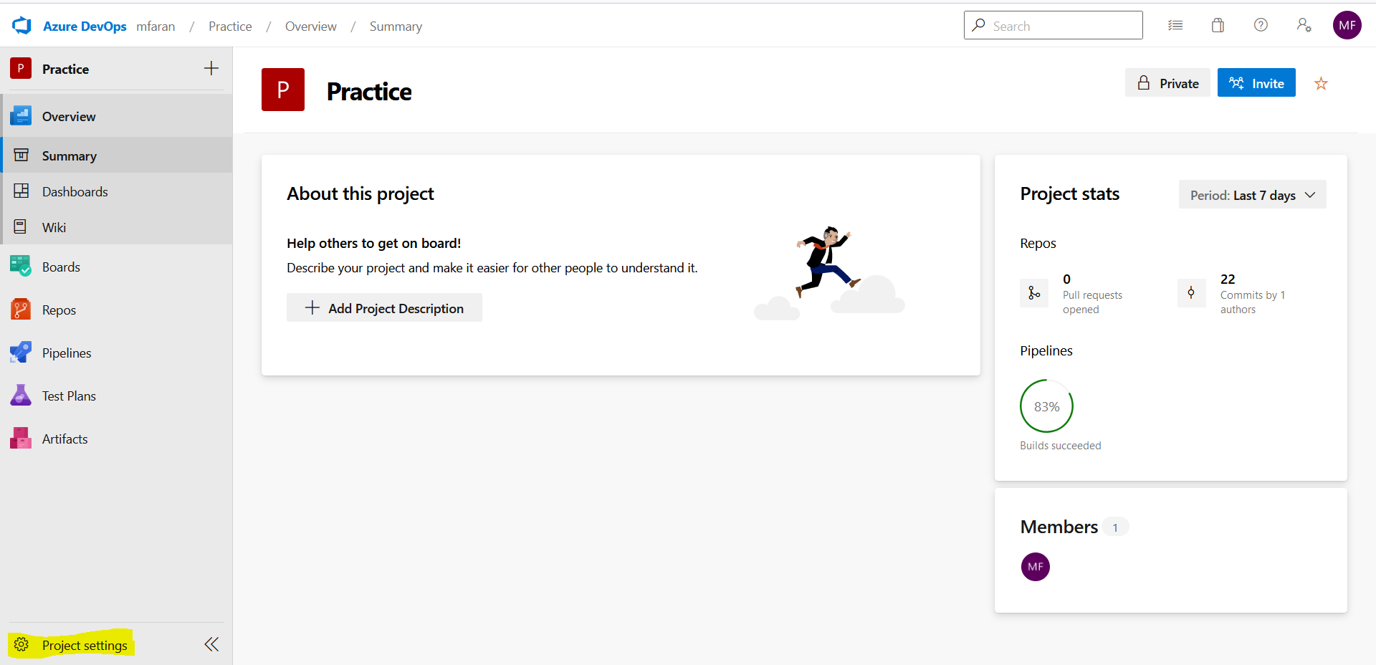
Go To Project Settings
www.corvit.com

Slide 14
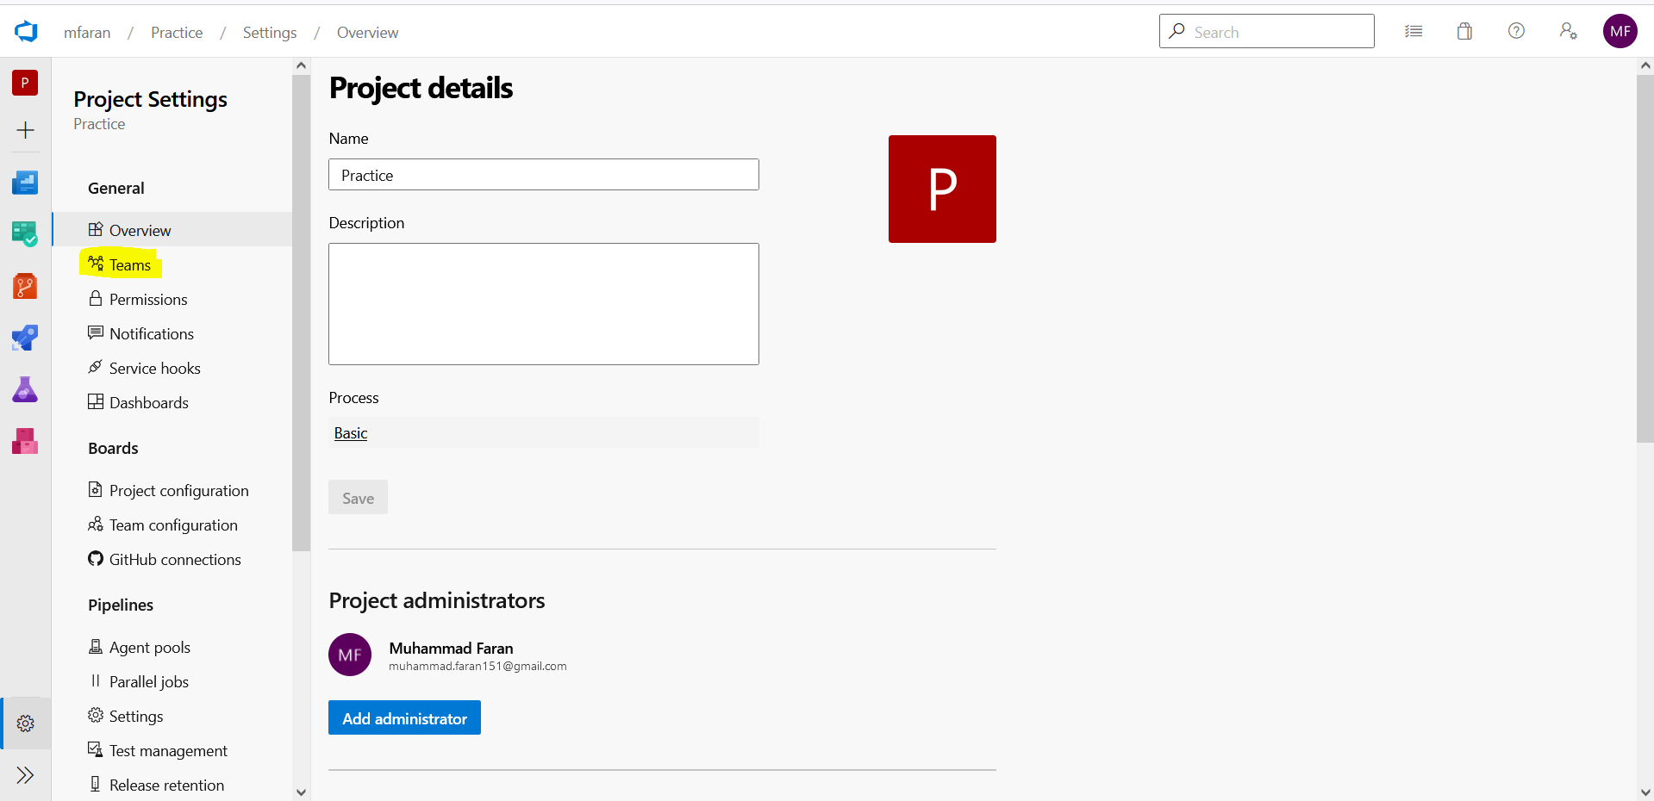
Click Teams Options
www.corvit.com

Slide 15
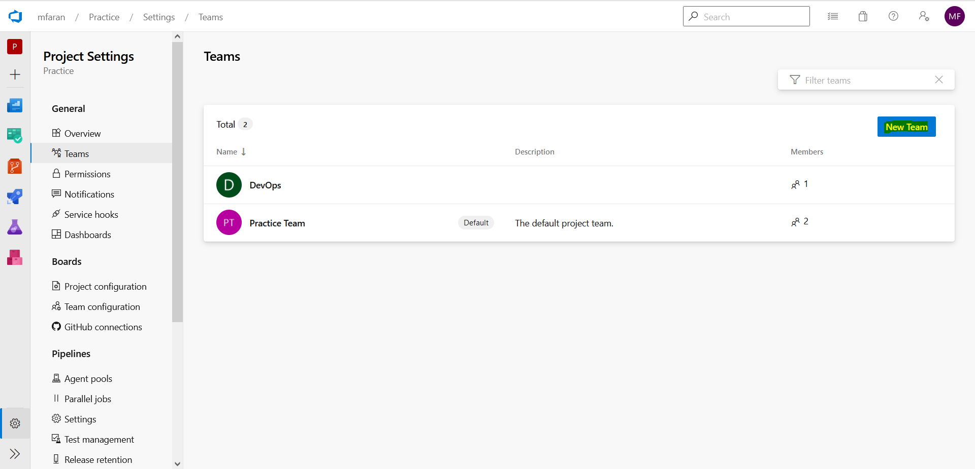
Click On New Team
www.corvit.com

Slide 16
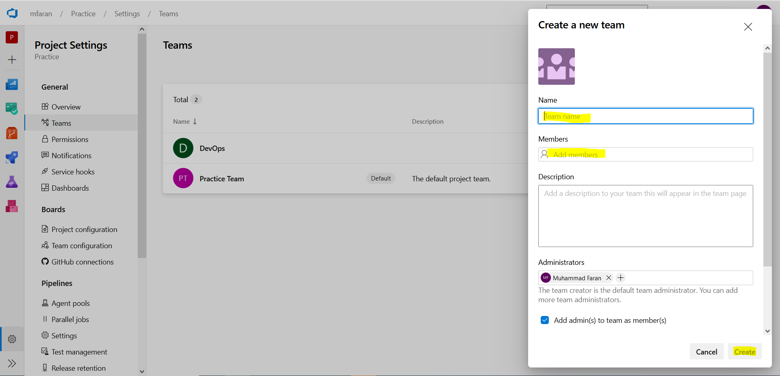
Enter Name, Member And Press Create Button
www.corvit.com

Slide 17
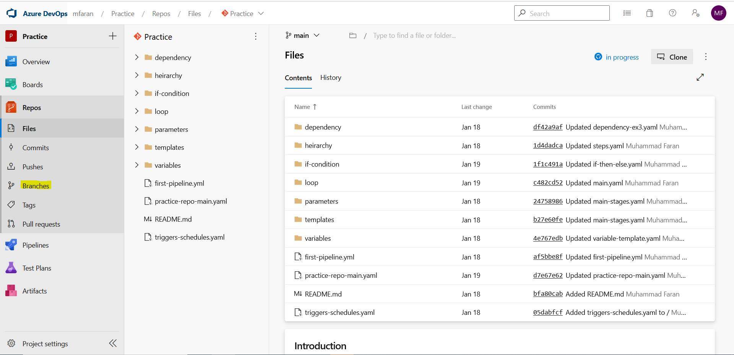
Go To Repository And Select Branch Option
www.corvit.com

Slide 18
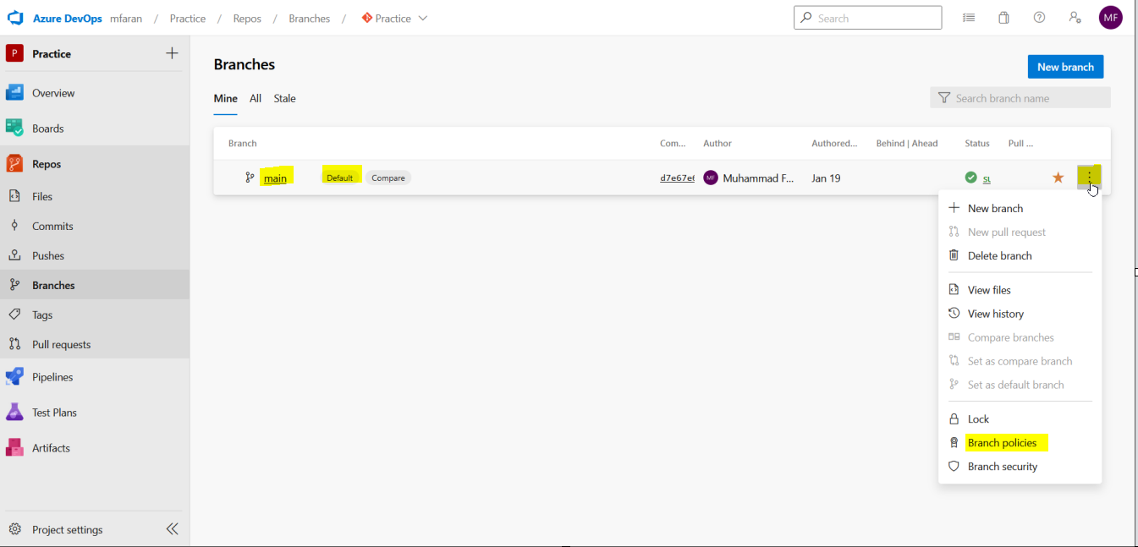
Select Default Branch And Click On Three Dot Icon And Then Select Branch Policies
www.corvit.com

Slide 19
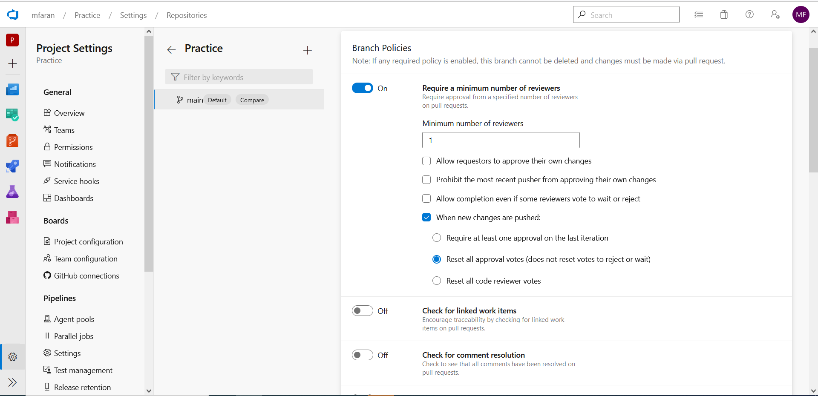
Configure As Done In Screenshot
www.corvit.com

Slide 20
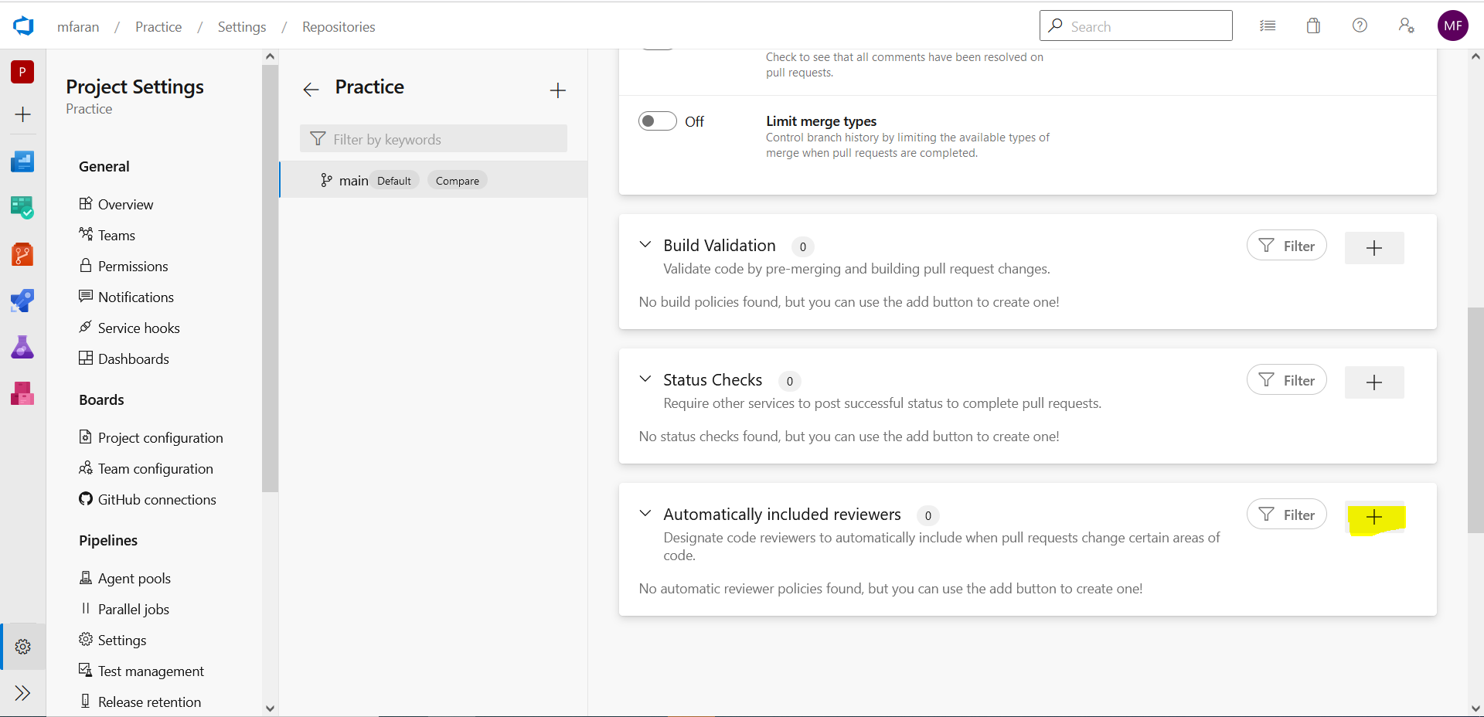
Add Reviewer
www.corvit.com

Slide 21
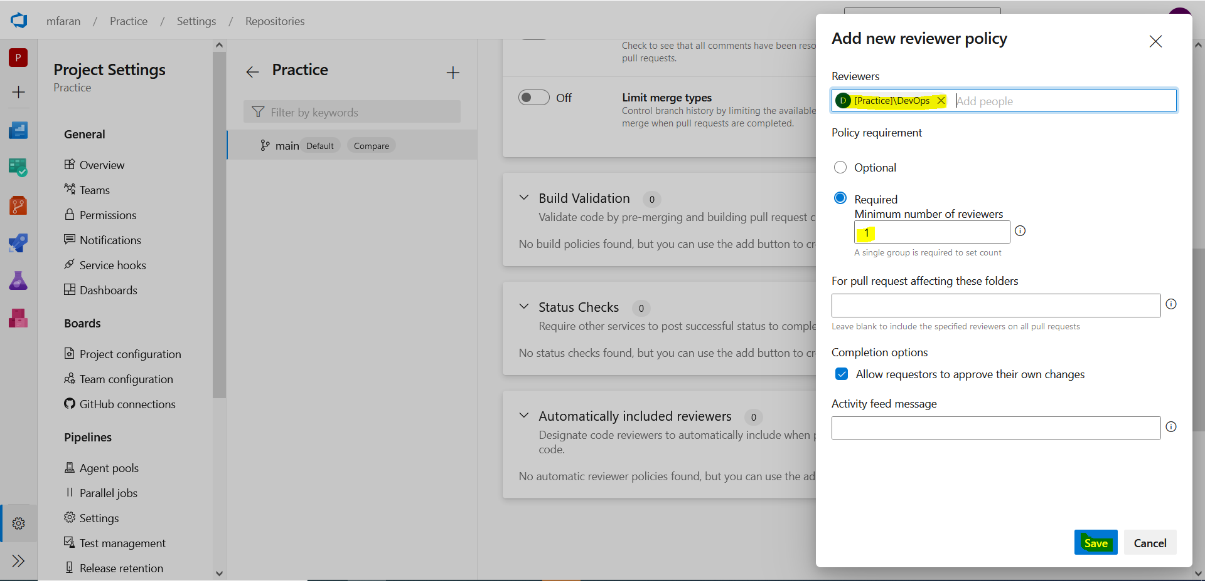
Configure As Shown
www.corvit.com

Slide 22
Fork
Git doesn’t let anyone access your project and make changes to it. Git provides a way to allow your team to contribute to your project which is through Fork. The other way is to allow access to the main project.
Fork just make a copy of the project and allows the added user to access that copy and make changes to that.
Your own account URL is known as origin but the URL from where you had forked the project is known as upstream URL
git remote add upstream <url> (adding upstream url to local)
www.corvit.com

Slide 23
Pull Request (PR)
Once all the changes are made to the forked copy, user commits all the changes and request to merge those changes to the main branch this request to merge the changes to main branch is known as Pull Request.
After reviewing all the changes the owner approves the PR and all the changes are merged to main branch.
A user cannot push changes to upstream but to origin only as the upstream is from where user had forked and origin is personal
Only a single PR can be in active state for a particular branch. Different commits made would be added to the active PR. So always create different branches for different bugs/features so separate PRs can be made.
git push origin tempbranch (git automatically prompts to create PR after this command on git account).
www.corvit.com

Slide 24
Syncing Forked Project With Main
Once the PR is merged the changes are pushed to main branch of upstream but changes are present at forked copy on Git Hub. For that there are different methods
Git Hub gives you a option of fetch upstream, just click that and your forked main branch would be synced with upstream.
git checkout main git fetch --all --prune (fetches all commits which are even deleted) git reset --hard upstream/main (reset main branch of forked project with main branch of main project) git push origin main (pushes the changes to the forked project).
git pull upstream main (does the same as fetch and reset did altogether). git push origin main
www.corvit.com

Slide 25
Squashing Commits
Git allows us to merge different commits to a single commit. We have to pick and squash commits. Pick would be the commit in which we want to merge other commits and squash would be the commits which would be merged in the picked commit.
git rebase -i <picked commit id> (it would open a new prompt where you would pick and squash commits) esc:x after choosing then add message exc:x this would merge the commits.
www.corvit.com

Slide 26
Merge Conflicts
When git receives different changes for same line of code it terms as a merge conflict and prompts to remove it and then again try to merge.
Open the conflict file and remove line of code which you don’t and save it with ones you want and push it again to resolve the conflict.
www.corvit.com

Slide 27
Cherry Picking
git cherry-pick <commit id>
Applies the given commit on the current branch
www.corvit.com

